Slide 1
FTIR Imaging - Introduction
FTIRI provides a “chemical photograph” in thin sections of tissue
The tissue must be sufficiently thin to allow the passage of infrared radiation (1-2 um for bone, 2-5 for cartilage, skin and tendon.
The process is non-destructive in that there are no dyes or other treatments, thus the thin sections can be reused for other applications.
This tutorial will describe parameters validated for bone and dentin and provides examples of the types of questions that might be asked.
For other applications please contact the core technician or director.

Slide 2
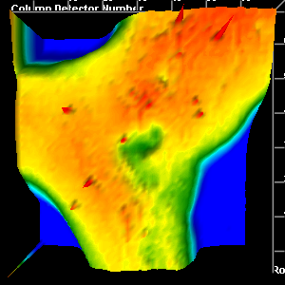
Chemical Photography of Bone Composition
1a
PMMA
PMMA
PO
PO
3-
4
3-
4
AMIDE I
AMIDE I
AMIDE II
AMIDE II
CO₃⁼
CO₃⁼
1700
1700
1700
1700
1600
1600
1600
1600
1500
1500
1500
1500
1400
1400
1400
1400
1300
1300
1300
1300
1200
1200
1200
1200
1100
1100
1100
1100
1000
1000
1000
Wavenumber (cm⁻¹)
1000
Wavenumber (cm⁻¹)
1b
1c
5.000
4.000
3.000
2.000
1.000
0
Mineral
Mineral:Matrix
3
1d
Wt % CO
2-
0.41
11.6
0.39
1.000
0.37
10.4
0.8000
0.35
0.6000
0.33
9.2
0.31
0.4000
0.29
8.1
0.2000
0.27
0.25
7.0
0
0.23
0.21
5.8
Crystallinity
0.19
0.17
4.7
Carbonate
0.15

Slide 3
Chemical Photography of Bone Composition
1a
PMMA
PMMA
PO
PO
3-
4
3-
4
AMIDE I
AMIDE I
AMIDE II
AMIDE II
CO₃⁼
Sugars
CO₃⁼
Lipids
1700
1700
1700
1700
1600
1600
1600
1600
1500
1500
1500
1500
1400
1400
1400
1400
1300
1300
1300
1300
1200
1200
1200
1200
1100
1100
1100
1100
1000
1000
1000
Wavenumber (cm⁻¹)
1000
Wavenumber (cm⁻¹)
1b
1c
5.000
4.000
3.000
2.000
1.000
0
Mineral
Mineral:Matrix
3
1d
Wt % CO
2-
0.41
11.6
0.39
1.000
0.37
10.4
0.8000
0.35
0.6000
0.33
9.2
0.31
0.4000
0.29
8.1
0.2000
0.27
0.25
7.0
0
0.23
0.21
5.8
Crystallinity
0.19
0.17
4.7
Carbonate
0.15

Slide 4
First Report 1998
Cell Mol Biol (Noisy-le-grand). 1998 Feb;44(1):109-15.
Infrared microspectroscopic imaging of biomineralized tissues using a mercury-cadmium-telluride focal-plane array detector.
Marcott C, Reeder RC, Paschalis EP, Tatakis DN, Boskey AL, Mendelsohn R.
Abstract
A 64 x 64 mercury-cadmium-telluride focal-plane array detector attached to a Fourier transform infrared microscope was used to spectroscopically image 5 microm sections of canine alveolar bone tissue in the fingerprint region of the infrared spectrum. By ratioing the relative intensities of specific bands across the images, it is possible to obtain spatial distributions of the mineral-to-matrix ratio and mineral maturity as a function of distance from an osteon.

Slide 5
Validated FTIRI Parameters

Slide 6
Mineral:Matrix Ratio
FTIR mineral:matrix ratio correlates with ash fraction
Ash Fraction
FTIR Mineral:Matrix Ratio

Slide 7
Mineral Crystallinity
FTIR crystallinity correlates with c-axis length assessed by x-ray diffraction
c-axis dimension (Ǻ)
FTIR Crystallinity

Slide 8
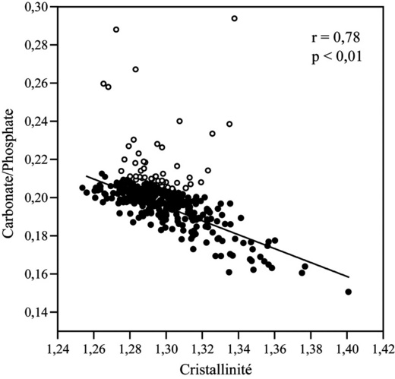
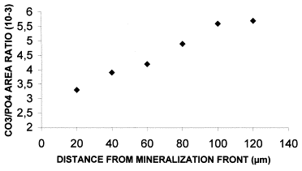
Carbonate:Phosphate Ratio Validated Chemically
Magne et al., Bone, 2001

Slide 9
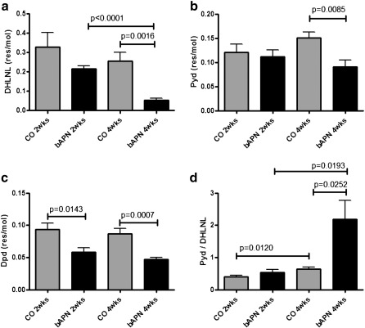
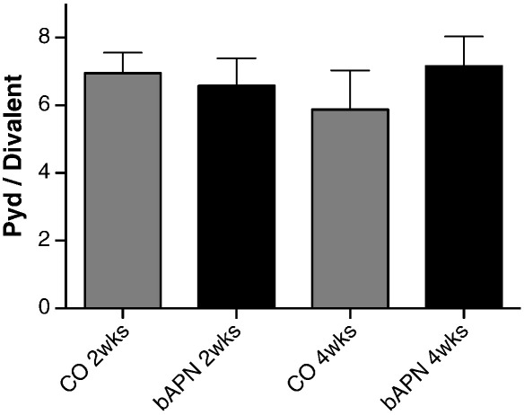
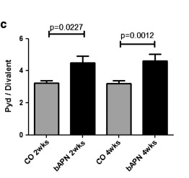
Collagen Maturity (XLR)
Whole bone Chemistry
Bone surface FTIRI
Cortical Periosteal surface
Paschalis et al., Bone, 2011

Slide 10
FTIRI Parameters Correlate with Mechanical Properties

Slide 11
Vertebral bone strength correlates with vertebral crystallinity
30
Stress (MPa)
25
20
R²= 0.29 p= 0.03
15
0.6
0.8
1.0
1.2
1.4
1.6
1.8
2.0
2.2
1030/1020 (area ratio)
Weinstein et al., Aging Cell, 2010

Slide 12
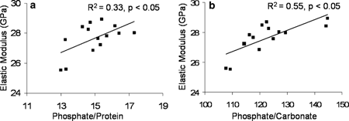
Synchrotron Data
Judex et al, Calcif Tissue Int, 2005

Slide 13
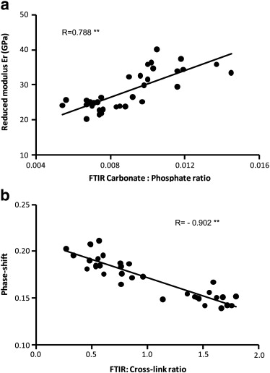
Bone Volume 47, Issue 6 2010 1030 - 1038

Slide 14
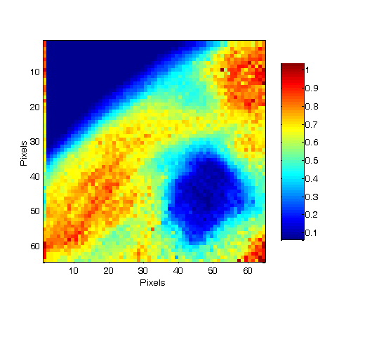
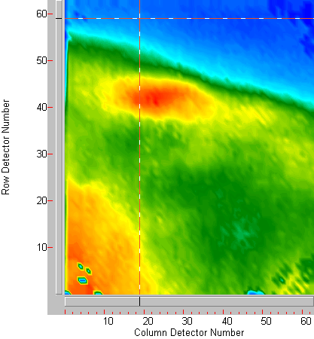
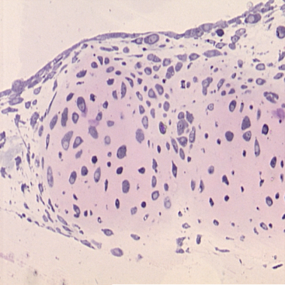
What is needed to perform FTIRI of Bone
FTIRI is a transmission experiment = thin sections
Imaging Spectrometer
Software for data processing
  Embedding media: PMMA, Spurs, LR-white
  Zebra fish and calvaria, cell culture
Scales
D16, 4P

Slide 15
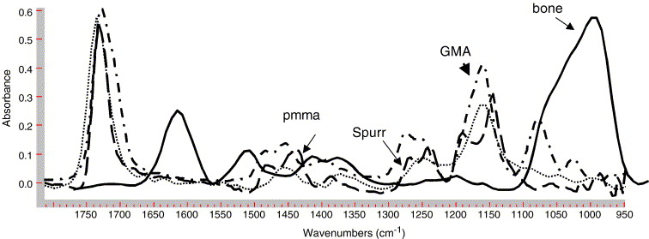
EFFECT of EMBEDDING MEDIA
PMMA, Spurr, but not GMA can be removed by spectral subtraction.
Boskey et al, BBA, 2006

Slide 16
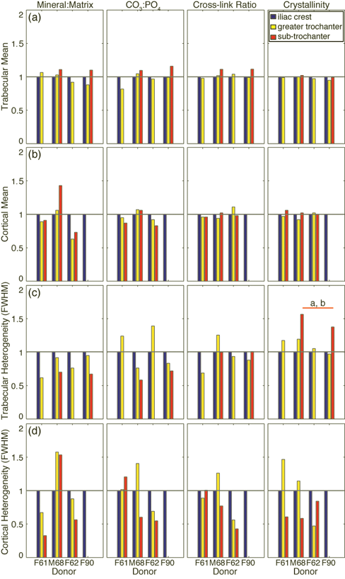
Tissue Heterogeneity:
Select a Single Tissue for Comparison
Values normalized to those at the iliac crest. Missing bars indicate that the tissue type was not present in the biopsy, n=4
Mean values of all parameters similar across sites (a,b).
Heterogeneities more variable across sites (1c,d).
In trabecular tissue, the heterogeneity of the crystallinity at the sub-trochanter was greater than that of the iliac crest (+46%, p=0.008) and the greater trochanter (+36%, p=0.019).
No differences in heterogeneities of other trabecular tissue properties, nor in heterogeneities of cortical parameters.
(Donnelly et al., JOR, 2011)

Slide 17
Processing FTIRI Data
Subtract contribution of embedding media and water vapor
Display raw images
Univariate analysis
  Mapping parameters
  Curve fitting and deconvolution
Multivariate analysis
  PLS, Cluster Analysis, Factor Analysis

Slide 18
Table I
References available on request

Slide 19
Applications : Answering Specific Questions about Bone

Slide 20
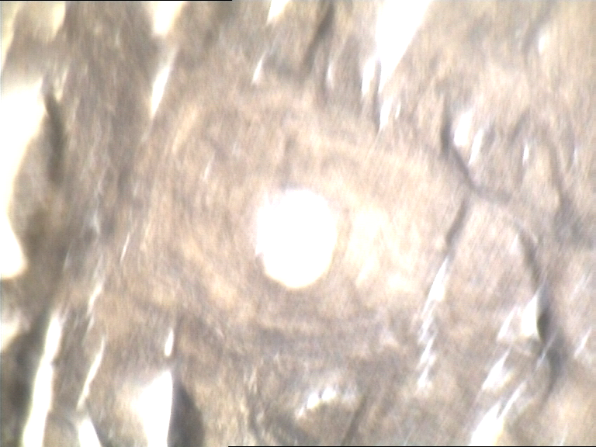
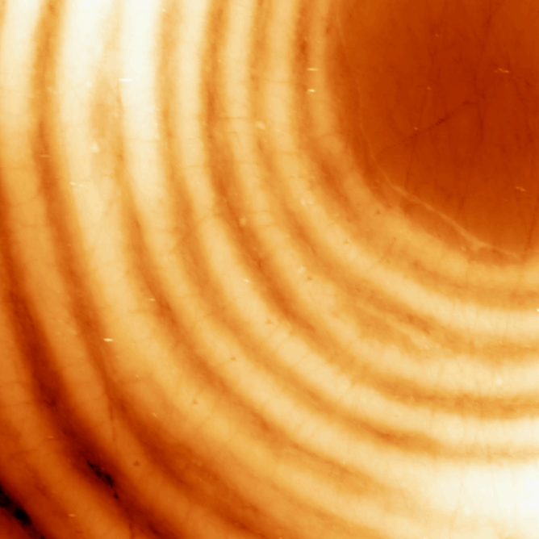
Effect of Tissue Age: Healthy Baboon Study
100%
50%
10%
Mineral to Matrix Ratio
SHG
Gourioon-Arsiquaud et al JBMR, 2010

Slide 21
Mineral/Matrix, Crystallinity & CO3/Amide I
2.5

Slide 22
Collagen Cross link Ratio (XLR)

Slide 23
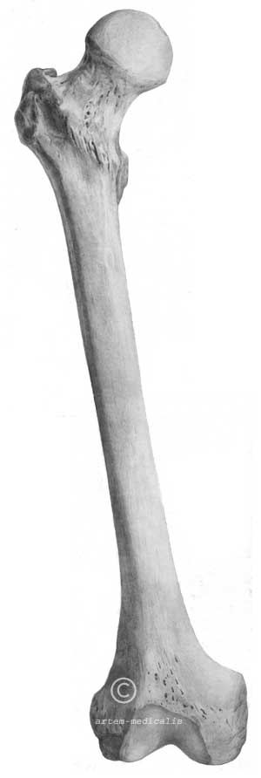
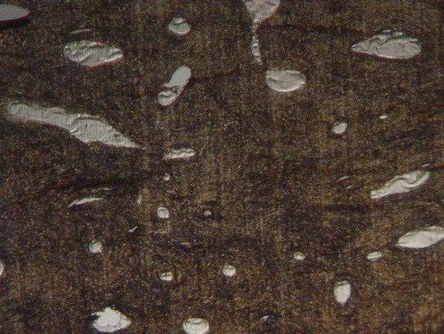
Age Dependent Changes in Mature Human Bones
Interstitial tissue has higher Min/Mat than secondary or old osteons
FTIR
Secondary
Osteon
Interstitial Tissue
Old Osteon
Cadaveric Femurs
Cadaveric Femurs
Male (n = 12) | Middle-aged (n = 6) Old (n = 6) | Secondary Osteons x 3 Old Osteons x 3 Interstitial x 3
M. Reyes, Dissertation, U Tx San Antonio

Slide 24
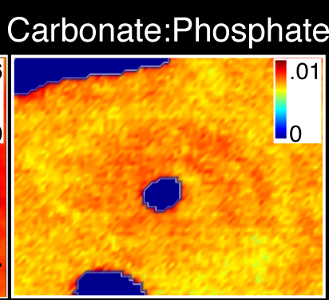
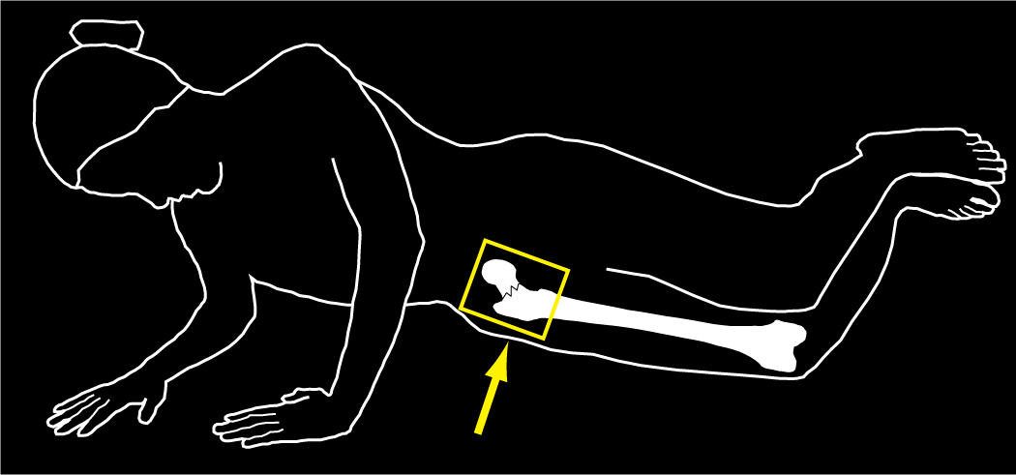
Can FTIR Parameters Predict Fracture Risk Independently of BMD?
Collagen Maturity
Crystallinity
Crystallinity
[Gourion-Arsiquaud et al. 2009]

Slide 25
FTIRI Parameters Predictive of Fracture Risk – Iliac Crest Biopsies
Global averages – all parameters
* p<0.05; **p<0.001; n=52

Slide 26
Multiple logistic regression model
Fracture (0/1) = bo +b1BMD +b2age +b3 Rx +b4(min/mat) +b5(xstl) + b6(XLR) + b7(CO3/P)
Notes:
Fix b and beta and replace talble with p next to p

Slide 27
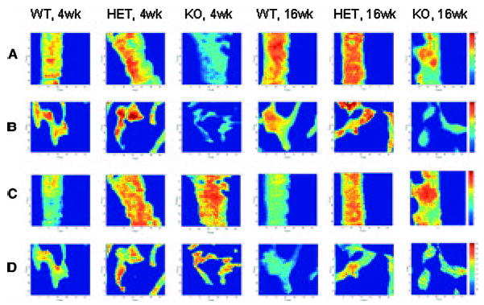
Studies of KO animals: DMP-1 KO
Min//Mat
XST
Ling et al., JBMR 2005

Slide 28
Studies in mutant animals: models where collagen synthesis is defective
*
*
Coleman, et al. Bone, 2012

Slide 29
Effects of Treatment
Placebo
ALN
7
7
6
6
*
*
5
5
4
Parameter Mean
4
3
3
2
2
*
*
1
1
0
0
M/M
C/P
C/Am I
Xst
XLR
M/M
C/P
C/Am I
Xst
XLR
Cortical Bone
Cancellous Bone
Mineral/Matrix significantly increased in women without fractures treated 2 yrs with ALN
Boskey et al., 2009

Slide 30
Compositional Heterogeneity
Healthy bone has a broad distribution of tissue properties reflecting the presence of new and old bone
A heterogeneous tissue may be better able to resist crack propagation [Burr & Martin 1986]

Slide 31
Heterogeneity is Decreased in the ALN treated patients
Placebo
ALN
6
5
4
*
*
FWHM
3
*
*
*
*
2
*
*
1
0
M/M
C/P
C/Am I
XLR
XST
M/M
C/P
C/Am I
XLR
XST
Cortical Cancellous

Slide 32
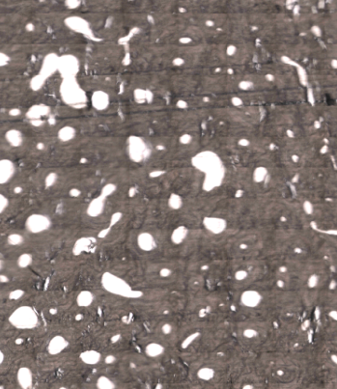
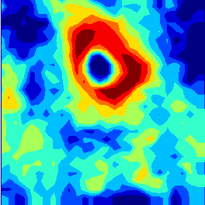
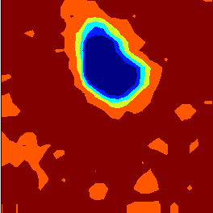
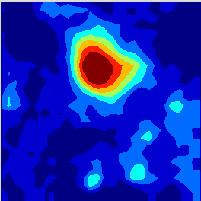
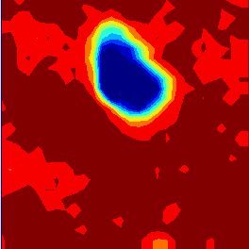
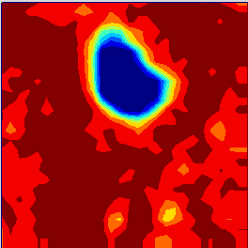
Multivariate Analysis: PLS, Factor Analysis, Cluster Analysis, Neural Networks
Factor Analysis
Factor Loadings
F1
F4
F6
F2
F5
F1
F3
F6
Spevak et al., Calcif Tissue 2013

Slide 33
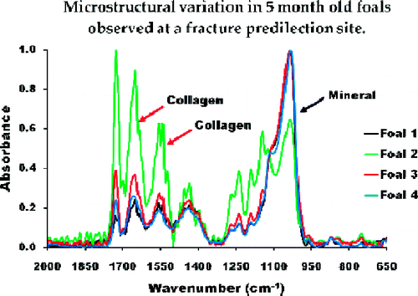
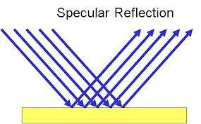
Future Directions
Specular Reflection (SR)
Reflection from a mirror
Nicholson et al., Anal Chem 2012 84(7) 3369.
Racehorse calcified cartilage and subchondral bone (uniform age) at potential sites of fracture

Slide 34

Future Directions – AFM IR to be acquired July 2014
nanoIR Spectra Collected at Different Distances from Osteon Center
AFM image 60 x 5 μm
© 2012 Anasys Instruments

